Slide 1

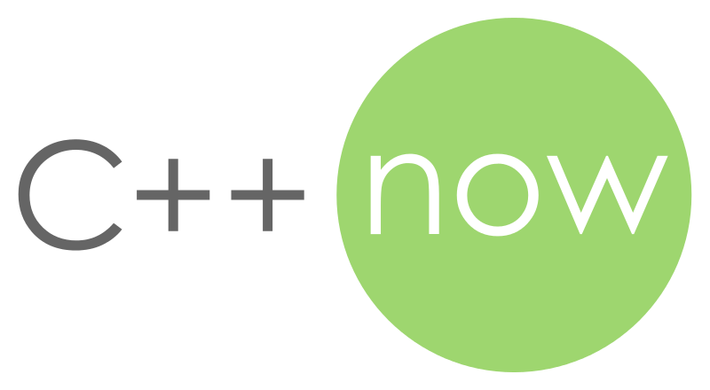
Compile Fast Run Faster Scale Forever
A Look into the sol Lua Binding Library
ThePhD
May 10th, 2018

Slide 2
Why “ThePhD”?
It’s a std::promise<> for my std::future<>
Finishing undergrad in about a year
Debating industry vs. graduate school
Actually stands for “The Phantom Derpstorm”
’cause bad at video games 😅

Slide 3
Lua
Small scripting language used in tons of places
Databases (e.g. Redis)
Operating System components
Tons of game projects/engines that are not Unreal
High Performance Computing projects
GUI Scripting (Waze/OpenMPT)
Chat servers, Server management
And so on and so forth…

Slide 4
sol2
Lua <-> C++ interop library
Started by Danny “Rapptz” Y. (M.D.) as just sol
C++14 and better
sol3: Making a break for C++17/20 soon
Written on top of Lua C API
Provides C API compatibility layers

Slide 5
Established
sol is Mature, used in many industries and projects
Has competed against all other libraries (20+) and more or less survived + thrived
Except in the case of compilation speed

Slide 6
The Interface
What exactly would make a good interface for Lua in C++?

Slide 7
Language Parity
Lua has….
Tables (serves as arrays, maps, class-proxies, …)
Numbers (always doubles until Lua 5.3, which introduced integers up to 64 bits signed)
Functions (as first class citizens, closures are easy)
Strings (Lua literals are encoded as utf8 by default)
Let me show you…

Slide 8
What would C++ look like…?
double timing = lua[“timing”]; function func = lua[“func”]; bool result = func(1, 2); std::tuple<int, int> result2 = lua[“callable”](4, 2); // multiple returns lua[“signal”] = true; lua[“signals”] = make_new_table(); lua[“signals”][1] = [](int v) { std::cout << “beep with” << v << ‘\n’; }; lua.script(“if signal then signals[1](20) else print(‘boop’)”);

Slide 9
“Pinching Point”
The stack abstraction and why it matters

Slide 10

Stacks!
Lua’s C API is stack-based
Annoying to manage, even when understood
Defines all interop for types
Primitives (numbers (integers), strings, tables, functions) to complex entities
Custom types (userdata, lightuserdata)

Slide 11
Good to use for simple things…
my_table[“a”]
get ‘my_table’ global – lua_getglobal(L, “my_table”)
get field – lua_getfield(L, -1, “a”) // negative numbers count from top of stack
retrieve value: lua_to{x}(…) value (where x is number/userdata/string)
my_func(2)
push ‘my_func’ global function – lua_getglobal(L, “my_func”)
push argument – lua_pushnumber(L, 2)
call, get return(s) – lua_pcall(…), lua_to{x}(…), lua_pop(L, …)

Slide 12
(╯°□°）╯︵┻━┻ !!
other_func( my_table[“a”][“b”], my_func(2) )
Lua’s C API does not scale with complexity
amount of necessary boilerplate
developer time

Slide 13
sol::stack
Non-self-balancing, stack-changing API wrappers
sol::stack::get<Type>( L, stack_index, record);
int num_pushed = sol::stack::push( L, anything);
sol::stack::check<Type>( L, stack_index, handler, record);
sol::stack::check_get<Type>( L, stack_index, handler, record);
int res = stack::lua_call<…>( L, from, cpp_callable, extra_arguments… );
record tracks how many items are used / pulled from the stack

Slide 14
Fixed interop points
Each struct is a template that has a sole responsibility, can override for custom behavior
struct sol::stack::getter<T, C= void> (.get(…))
struct sol::stack::pusher<T, C= void> (.push(…))
struct sol::stack::checker<T, sol::type, C= void> (.check(…))
struct sol::stack::check_getter<T, sol::type, C= void> (.check_get(…))
sol::stack::lua_call<…>(…) uses other functions to perform the call

Slide 15
Scalability requires Defaults
Problem: C++ has a lot more types than integers, floating point, strings, functions and table-alikes
Need a sane default for some user-defined type T
Treated as userdata, which is a blob of memory

Slide 16
Some Types are Special
std::pair / std::tuple
Lua has multiple returns, allow multiple-returns from C++ with these
std::vector/std::list/std::map/ … - Lua has tables which emulates these
convert to table (expensive, but plays nice), or
store C++ container userdata (direct, fast, but plays less nice with Lua ecosystem)
std::wstring/std::u16string/std::u32string
Unsurprisingly, people want these types to work – must UTF encode on push and on get.

Slide 17
What we are doing
get
check(_get)
push
C++
Lua
Uniform conversions to and from, based on type
System is now well-defined for any given type, and easier to reason about

Slide 18
sol::reference
The cornerstone abstraction

Slide 19
Rule of 0 for Lua Binding
sol::reference is a reference-counting object for something that is taken from Lua
Stored in the Lua registry, a heap of memory to keep Lua objects alive
Slower than stack, faster than literally any other serialization scheme
Basically a Lua-specific version of the upcoming std::retain_ptr<T, R>
https://wg21.link/p0468r0

Slide 20
Formula for Success
1 – Derive from sol::reference
2 – Add no data members, just functionality and type-safety
3 – ???

Slide 21
4 – Profit
sol::object – generic object for doing .is<T>() checks and .as<T>() conversions
sol::table – allows operator[] indexing
sol::function – allows operator() for calling in C++
sol::thread – encapsulates a Lua thread (not like a C++ thread; it’s separate stack space)
sol::coroutine – like sol::function, but works off a stack space (thread)
sol::state_view – cheap look at a Lua state, takes out a sol::table for registry and globals
sol::state – sol::state_view + std::unique_ptr<lua_State*, lua_closer>

Slide 22
Magical Abstractions
Proxies, conversions and the missing Language Feature

Slide 23
Tables and []
Need to be able to apply the access-operator [] on tables
Optimizations to be applied for nested lookups – my_table[“bark”][“woof”]
Table lookup and global lookup actually have different C calls for Lua’s C API
Picking the right one / wrong one changes performances characteristics
… But gives same results (“API Trap”)

Slide 24
operator[]
Lazily concatenates / saves keys, generating a new proxy type
1 tuple entry per operator [ ] lookup
Commits lookup on any kind of assignment to proxy or implicit conversion of proxy
auto x = lua[“woof”][“bark”][1]; // decltype(x) == proxy<sol::global_table, const char*, const char*, int> double value = x; // triggers chained reads, attempts to conver to double x = “woof”; // triggers chained read into tables, then write into 1

Slide 25
proxy(_base) and friends
Let’s take a peek…

Slide 26
What was all that SFINAE, exactly?
Consider the simple case:
struct int_proxy { operator int () { return 2; } }; int_proxy ip{}; int value = ip; // nice, conversion const char* value_2 = ip; // boom, no conversion

Slide 27
Scaling up - 🦄 Proxy
struct unicorn_proxy { template <typename T> operator T () { /* arbitrary code can go here */ return T{}; }
}; unicorn_proxy up{}; int value = up; // nice, conversion const char* value_2 = up; // yay!

Slide 28
Oh no! 🗡️ 🦄
struct unicorn_proxy { template <typename T> operator T () { /* arbitrary code can go here */ return T{}; }
}; unicorn_proxy up{}; int value = 20; value = up; // Kaboooooom!

Slide 29
Left Hand Side is Queen
Implicit conversion operators take the type of the left hand side
EXACTLY as presented, qualifiers and references included
Cannot return a reference that is not fixed in memory
☠️ Cannot SFINAE/change return type! ☠️
Type “T” is not a regular return type
Cannot apply transformations not allowed by the language

Slide 30
Soon™ Paper: Extended Conversions
struct unicorn_proxy { template <typename T> int operator T () { // deduce from LHS… return 42; // but return whatever you want } };

Slide 31
function_result
Just another kind of proxy that has the same issues, manifests in other ways
Lua function f (v) return v, v * 2 end
C++
double a, b; std::tie(a, b) = lua[“f”](2); // error: std::tuple<int&, int&> return sol::tie(a, b) = lua[“f”](2); // ✔️: custom expansion and op=

Slide 32
Usertypes
A demo…

Slide 33
Overloading
Simple compile-time Overload Set reduction

Slide 34
Overloading
struct my_class {}; int bark ( int arg ); int woof ( std::string arg ); int bork ( int arg1, bool arg2, double arg3, std::vector<double> arg4 ); int borf ( bool arg ); int yip ( my_class& arg1, bool arg2 ); // create overloaded set lua[“f”] = sol::overload( bark, woof, bork, borf, yip );
What kind of cost to select right overload if we do: f(my_class.new(), true) in Lua?

Slide 35
Simulate
Lua calls:
f(my_class.new(), true)
must match:
my_class&, bool (arity of 2)
bark | woof | bork | borf | yip
1 arg | 1 arg | 4 args | 1 arg | 2 args

Slide 36
Simulate
Lua calls:
f(my_class.new(), true)
must match:
my_class&, bool (arity of 2)
bark | woof | bork | borf | yip
1 arg | 1 arg | 4 args | 1 arg | 2 args
Arity != 1

Slide 37
Simulate
Lua calls:
f(my_class.new(), true)
must match:
my_class&, bool (arity of 2)
bark | woof | bork | borf | yip
1 arg | 1 arg | 4 args | 1 arg | 2 args
Disallowed: std::integer_sequence<1>

Slide 38
Simulate
Lua calls:
f(my_class.new(), true)
must match:
my_class&, bool (arity of 2)
bark | woof | bork | borf | yip
1 arg | 1 arg | 4 args | 1 arg | 2 args
Arity != 4
Disallowed: std::integer_sequence<1>

Slide 39
Simulate
Lua calls:
f(my_class.new(), true)
must match:
my_class&, bool (arity of 2)
bark | woof | bork | borf | yip
1 arg | 1 arg | 4 args | 1 arg | 2 args
Arity == 2 Check types…
Disallowed: std::integer_sequence<1, 4>

Slide 40
Simulate
Lua calls:
f(my_class.new(), true)
must match:
my_class&, bool (arity of 2)
bark | woof | bork | borf | yip ✔️
1 arg | 1 arg | 4 args | 1 arg | 2 args ✔️
Disallowed: std::integer_sequence<1, 4>

Slide 41
Safety is Optional
But not std::optional

Slide 42
Queries can be made safe…
int value = lua[“value”]; my_class my_obj = lua[“my_obj”]; my_class& my_obj_r = lua[“my_obj”]; // can manipulate memory directly my_class* my_obj_p = lua[“my_obj”]; // can manipulate memory directly
sol::function func = lua[“func”]; double x = f();

Slide 43
By slapping optional on it / checking
sol::optional<int> safe_value = lua[“value”]; sol::optional<my_class> safe_my_obj = lua[“my_obj”];
sol::optional<my_class&> safe_my_obj_r = lua[“my_obj”]; // nil = unengaged sol::optional<my_class*> safe_my_obj_p = lua[“my_obj”]; // nil = engaged
sol::function func = lua[“func”]; if (func.valid()) { throw std::runtime_error(“aaah”); } sol::optional<double> x = f();

Slide 44
std::optional does NOT cut it
For the reference case, would have to use some non_null< T* > struct and put that in optional
gsl::non_null is an alias, not a real struct – cannot control Proxy expressions based on it
Overhead for the struct + boolean (optional<T&> is compact)
Breaks library teaching:
“If you want safety, just wrap X in an optional”, compared to
“If you want safety, just wrap X in an optional, unless it’s a reference, then you need to use…”

Slide 45
Soon™ Paper: std::optional<T&>
Rebind on assignment
Only sane behavior
Do not allow rvalues to be assigned into optional reference
Prevents dangling lifetime issues
Reduce internal boilerplate code

Slide 46
std::future<sol>
What things are in the future for sol

Slide 47
Sol3: why?
“I had spent a whole day for moving my binding from tolua++ to sol2, I found my xcode became very very lag and compile time is about 10 minutes with about 8G heap,so I have to abandon xcode for coding.
I had spent another whole day for moving my binding from sol2 to kaguya, compile time is about 2-3 seconds.”
https://github.com/ThePhD/sol2/issues/538

Slide 48
Compile Times MATTER
Variadic templates lose absolutely 0 information in propagation
Can optimize the entire run time like crazy
Overused, overzealous application: reduce with initializer_list and other techniques
Saving compiler performance is a must
Will lose users without it

Slide 49
if constexpr
Probably the biggest thing that can be done
There is a LOT of tag-dispatch and SFINAE that ultimate results in binary choices
Things with fallbacks are the perfect candidate

Slide 50
Bloatymcbloatface
People have used this tool on executable which utilize sol2 and other analysis techniques on debug/release binaries
The amount of symbols / spam is E N O R M O U S

Slide 51
But the goal was runtime speed, right…?
Right: http://sol2.readthedocs.io/en/latest/benchmarks.html

Slide 52
The Last and Most Important Thing
Super important, I swear

Slide 53
DOCUMENTATION!!!
“Greetings. I used to use Sol but could not figure out how it works … and thus quickly switched over to Selene, since on its main page it had a much better tutorial/how-to-manual. However now I'm currently using Selene and thinking about switching to Sol2 (because it supports LuaJit, being able to switch between luajit and lua5.3 for comparison is quite nice) and i think has more features.”
https://github.com/ThePhD/sol2/issues/36

Slide 54
The Backbone of Any Project
Some projects are the “only alternative” so rather than reinvent
People muck through it and class APIs
Join an IRC to understand
Read the library’s tests to understand
sol has 20+ competitors, with more NIH Syndrome spawns more bindings
Bled users everywhere because of no docs

Slide 55
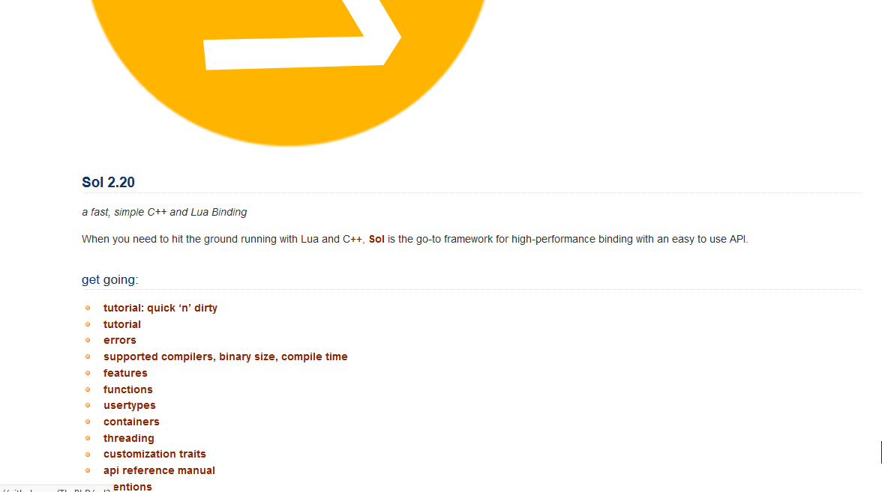
http://sol2.rtfd.io/

Slide 56
Thanks and Shilling
Support me and my family
Donation Links at the bottom of Docs Front Page and Readme
Donations have kept me fed for this trip, woo!
THANK YOU!:
Donators: Robert Salvet, Ορφέας Ζαφείρης, Michael Waller, Elias Daler (Dailidzionak Ilya) and Johannes Schultz
All of sol2’s users over the years

Slide 57
My Gratitude
Mark Zeren of VMWare, Simon Brand (@TartanLlama) of Codeplay
Pushed me to apply as a student Volunteer
Words of encouragement are powerful things ❤️
Jason Turner (@lefticus)
Spoke about sol before I ever had plans for it
Really encouraged me to speak and finally got to meet him 😄
I’m going to appear on CppCast! Monday, May 21st, 2018

Slide 58

More Gratitude
Hipony (Alexandr Timofeev) and kyzo (Alexander Scigajlo) for helping me bikeshed the logo in the Cpplang Slack!
#include
for showing me that even if there might not be people like me in many of the places I am going and want to go, that they will accept me as a regular human being all the same
Lounge<C++>
For always dragging me back in and being all around amazing nerds with great senses of humor

Slide 59
Questions? Comments?
E-mail: phdofthehouse@gmail.com
Twitter: @thephantomderp
Linkedin: https://www.linkedin.com/in/thephd/
Repository: https://github.com/ThePhD/sol2

